Slide 1
Capstone Engagement
Assessment, Analysis, and Hardening of a Vulnerable System

Slide 2
Table of Contents
This document contains the following sections:
01
Network Topology
02
Red Team: Security Assessment
03
Blue Team: Log Analysis and Attack Characterization
Hardening: Proposed Alarms and Mitigation Strategies
04

Slide 3
Network Topology
‹#›

Slide 4
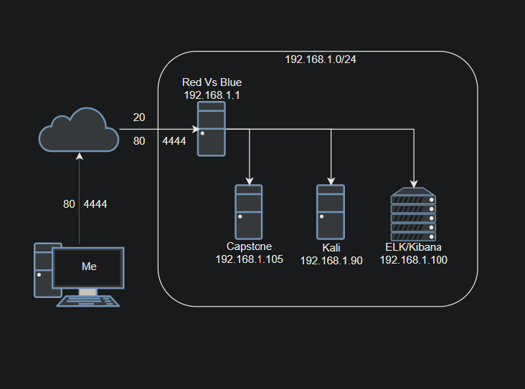
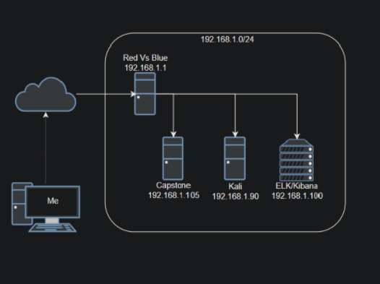
Network Topology
Network
Address Range: 192.168.1.0/24
Netmask: 255.255.255.0
Gateway: 192.168.1.1
Machines
IPv4: 192.168.1.1
OS: Windows
Hostname: RedVsBlue
IPv4: 192.168.1.100
OS: Linux
Hostname: ELK
IPv4: 192.168.1.105
OS: Linux
Hostname: Capstone
IPv4: 192.168.1.90
OS: Linux
Hostname: Kali

Slide 5

Red Team
Security Assessment
‹#›

Slide 6
Recon
Nmap identified the following hosts on the network:
Hostname | IP Address | Role on Network
Windows | 192.168.1.1 | VM Host
Capstone | 192.168.1.105 | Web Server (Host/Victim)
Kali | 192.168.1.90 | Pen Test (Attacker)
ELK/Kibana | 192.168.1.100 | SIEM

Slide 7
Vulnerability Assessment
The assessment uncovered the following critical vulnerabilities in the target:
Vulnerability | Description | Impact
Open Ports | Allows port scans via tools like nmap | Scans a network and reports back valuable information about it (ports, Os scans, etc.)
Brute Force | Hydra is a login cracker which supports numerous protocols to attack | Using Hydra allows attackers to find login credentials
PHP Reverse Shell Payload (Msfvenom) | PHP script that is configured according to the LHOST and LPORT parameters | Remote access

Slide 8
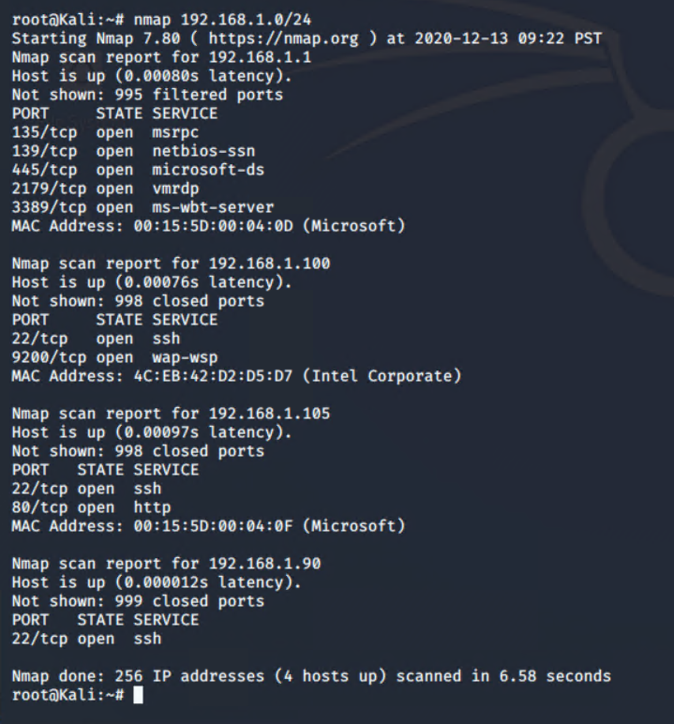
Exploitation: Nmap
01
02
Tools & Processes
Nmap - port scan
Achievements
Identified open ports
22 and 80 on ip 192.168.1.105

Slide 9
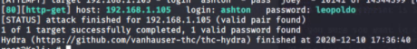
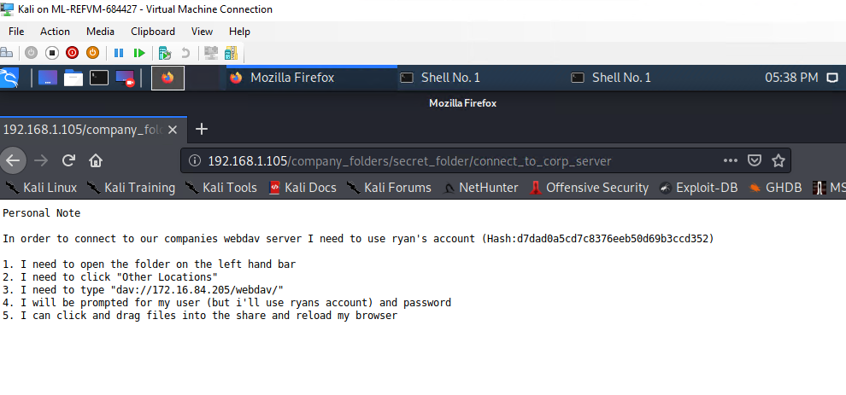
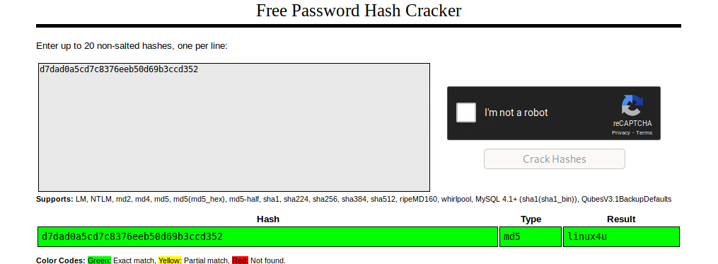
Exploitation: Brute Force
01
02
Tools & Processes
Hydra brute force password crack
Hash password crack
Achievements
Cracked user Ashton password to access /secret_folder
Crackstation.com

Slide 10
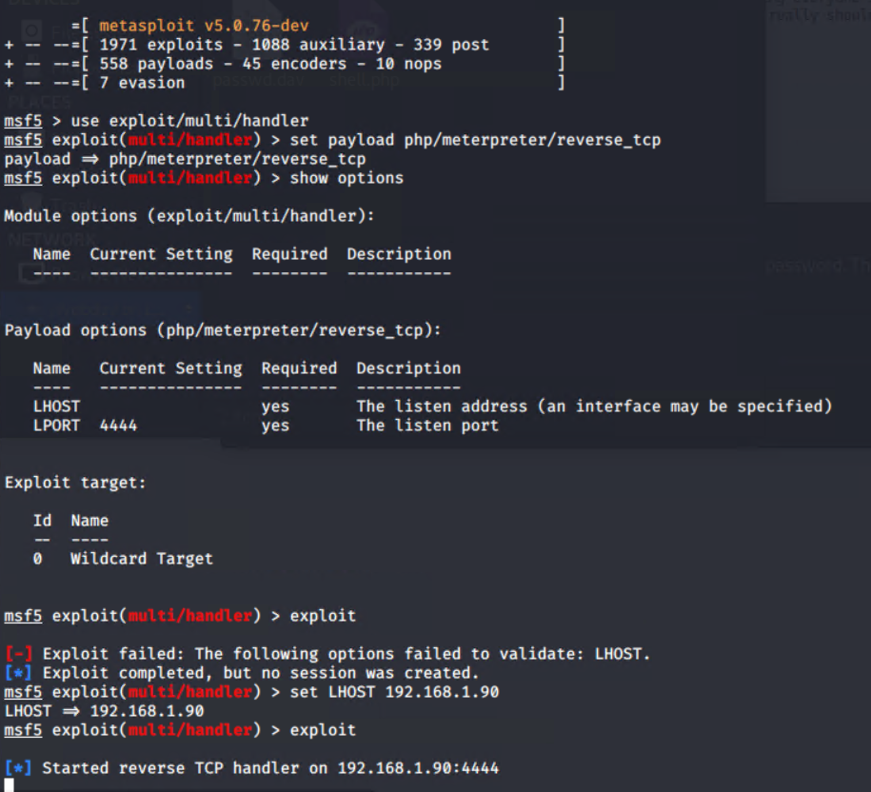
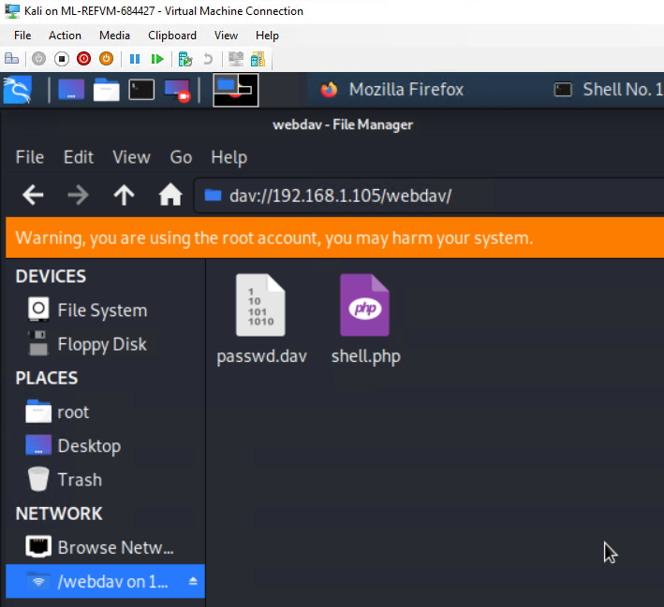
Exploitation: Reverse shell
01
Tools & Processes
msfvenom remote listener
Meterpreter reverse shell
02
Achievements
Access to Capstone root

Slide 11

Blue Team
Log Analysis and Attack Characterization
‹#›

Slide 12
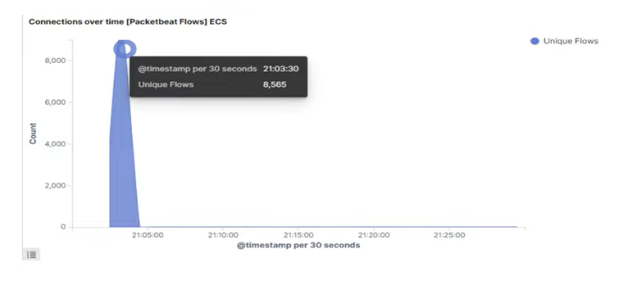
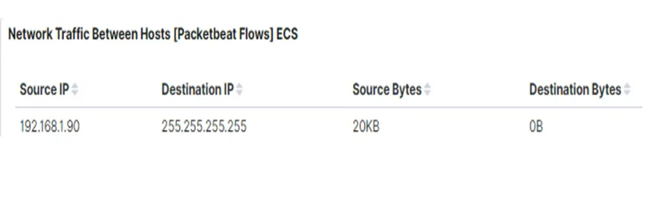
Analysis: Identifying the Port Scan

Slide 13
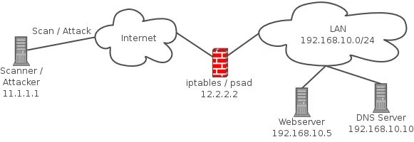
Analysis: Identifying the Port Scan
What time did the port scan occur?
13 Dec, 2020 1:14
How many packets were sent, and from which IP?
22,869 192.168.1.90
What indicates that this was a port scan?
The fact that these packets were sent indicates port scanning

Slide 14
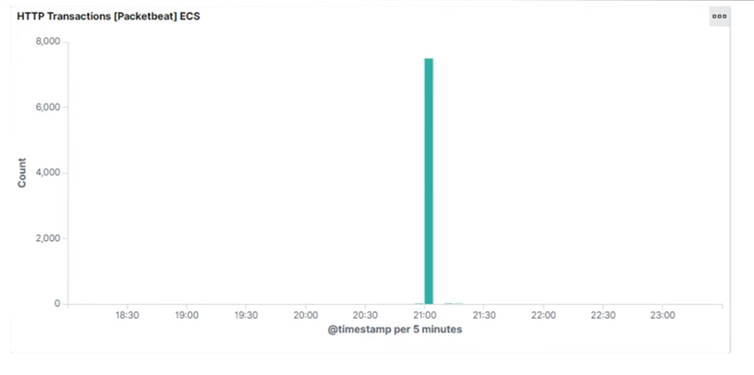
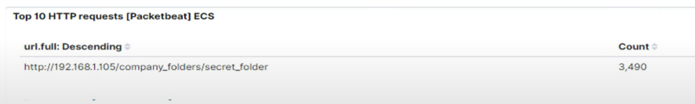
Analysis: Finding the Request for the Hidden Directory

Slide 15
Analysis: Finding the Request for the Hidden Directory
The request for the hidden directory occured at 21:05
The directory contained the following file:
192.168.1.105/company_folders/secret_folder/connect_to_corp_server

Slide 16
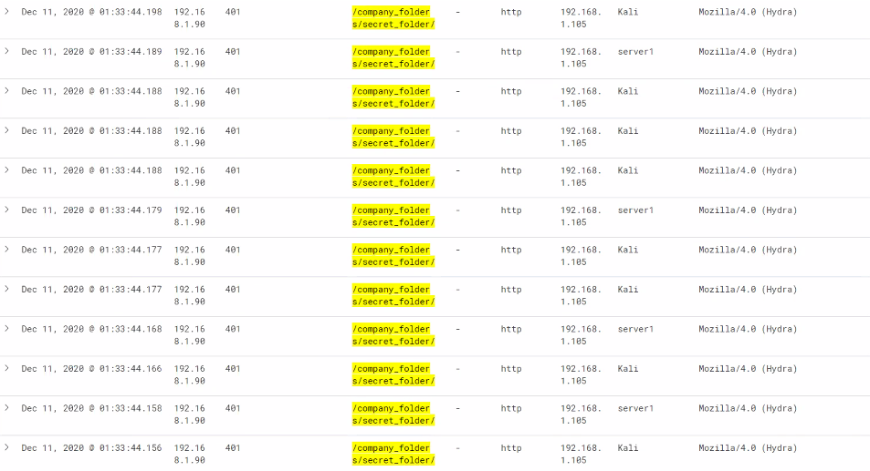
Analysis: Uncovering the Brute Force Attack
~6000 requests were made to access secret_folder

Slide 17
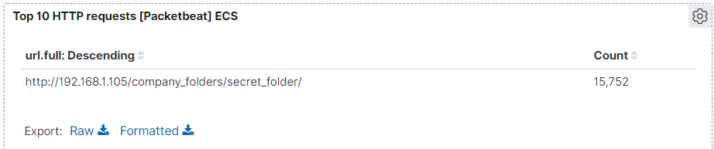
Analysis: Finding the WebDAV Connection
15,752 request were made to the password for secret_folder (6 out of 15,752 were successful)
secret_folder was requested 6 times

Slide 18
Blue Team
Proposed Alarms and Mitigation Strategies
‹#›

Slide 19
Mitigation: Blocking the Port Scan
What kind of alarm can be set to detect future port scans?
A Intrusion Detection System can be used to recognize scan attempts
Intrusion Prevention System to signal when multiple attempts at tcp connections occur over various ports
What threshold would you set to activate this alarm? 1
What configurations can be set on the host to mitigate port scans?
Log TCP connection attempts
Firewall configurations
Deployment of IDS/IPS systems
Alert for unusual port scans
Block port scans

Slide 20
Mitigation: Finding the Request for the Hidden Directory
What kind of alarm can be set to detect future unauthorized access?
Whitelist authorized ip addresses and detect attempts to connect to file system from unauthorized ip addresses.
What threshold would you set to activate this alarm?
Threshold would be 1 for unauthorized connection attempts
What configuration can be set on the host to block unwanted access?
Connections to this shared folder could be restricted by machine with a firewall rule
Files that are not required to be on this server should be removed
Describe the solution. If possible, provide required command lines.
Configure firewall to prevent/deny unauthorized access (non-whitelist)

Slide 21
Mitigation: Preventing Brute Force Attacks
What kind of alarm can be set to detect future access to this directory?
We could set an alert if 401 returned from any server over a threshold of 10 in 1 hour to prevent bruteforce login attempts
We could also create an alert for if the user_agent.original value includes Hydra
What configuration can be set on the host to control access?
After the limit of 10 401 Unauthorized codes have been returned from the server, that server can automatically drop traffic from the offending IP address for a period of 1 hour. We could also display a lockout message and lock the page from logging in for a temporary period of time for that user

Slide 22
Mitigation: Detecting the WebDAV Connection
What kind of alarm can be set to detect future unauthorized access?
We can create an alert for anytime the directory is accessed by a machine other than the machine that should have access
What threshold would you set to activate this alarm?
The first time the directory is accessed by a machine without permission the alarm is triggered
What configuration can be set on the host to block unwanted access?
Connections to this shared folder could be restricted by a machine with a firewall
Describe the solution.
Make connections to this shared folder not accessible from the web interface

Slide 23
Mitigation: Identifying Reverse Shell Uploads
What kind of alarm can be set to detect future file uploads?
Set an alert for if there is any traffic going through a specific port (ex 4444) or the specific ip (ex 192.168.1.105)
What threshold would you set to activate this alarm?
Any unauthorized activity will trigger the alert
What configuration can be set on the host to block file uploads?
Only give file upload access to authorized
ip addresses
Close unnecessary ports (e.g. 4444) and/or do not allow access and uploads through this port from unauthorized ip addresses

